Slide 1
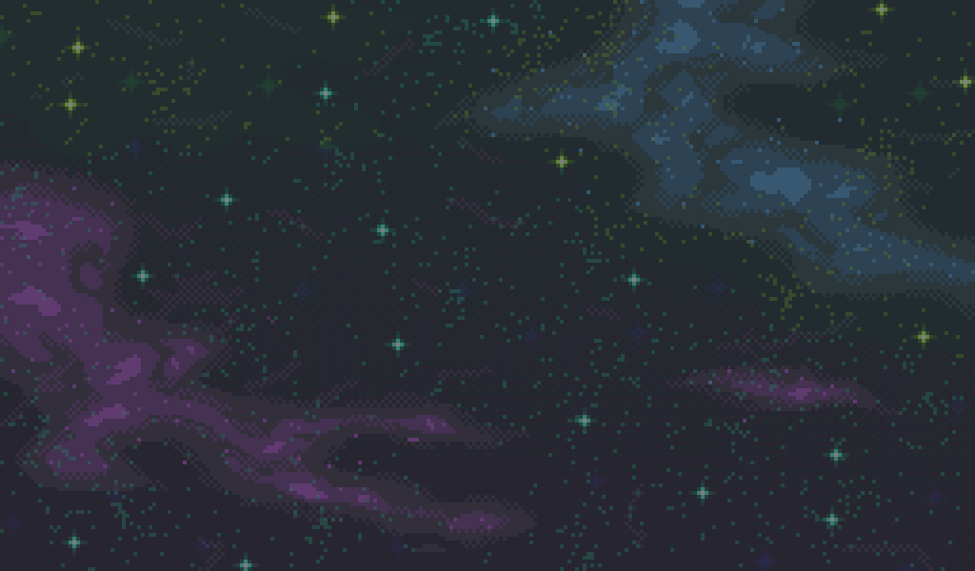

Galactic Conquest
Get ready to conquer space !
A Strategic Adventure in a Microgravity Environment
Flavie Gallois

Slide 2
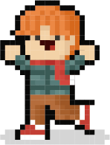
About myself
Flavie Gallois
Computer science student
Team project galactic conquest game
5

Slide 3
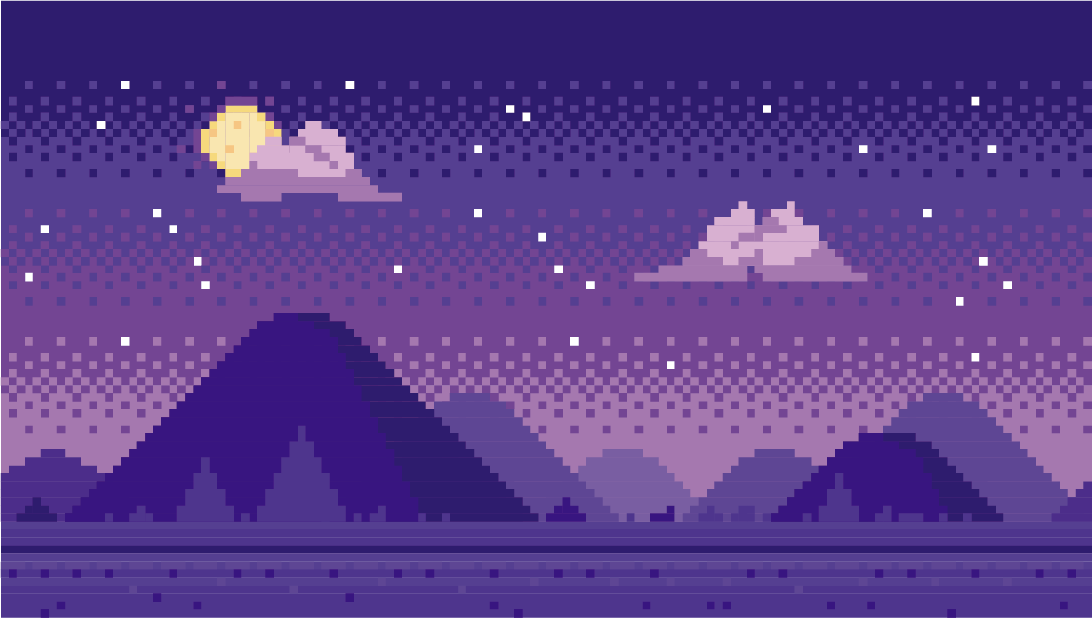
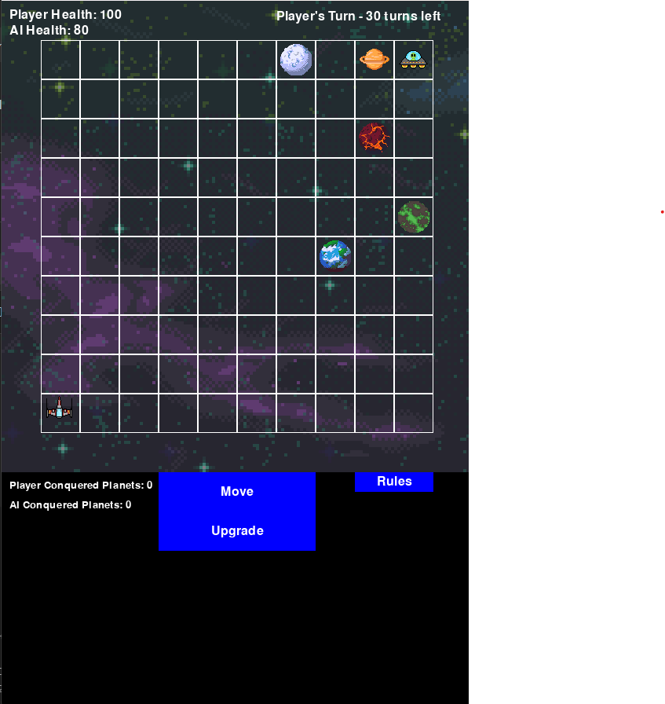
Game Overview
Turn-based strategy 2D Game
10x10 Grid
Two players : You and the enemy
Rules : Each turn choose between "Move" "Upgrade" or "Conquer" (only if you are next to a planet).
The goal of the game is, within the number of turn, either kill the enemy ship or if no one died, conquer the most amount of planets.
8

Slide 4

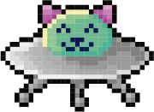
Centred text
This was my first time making a game
and my first time at a hackathon.
It was fun to do, thank you for the opportunity
11

Slide 5
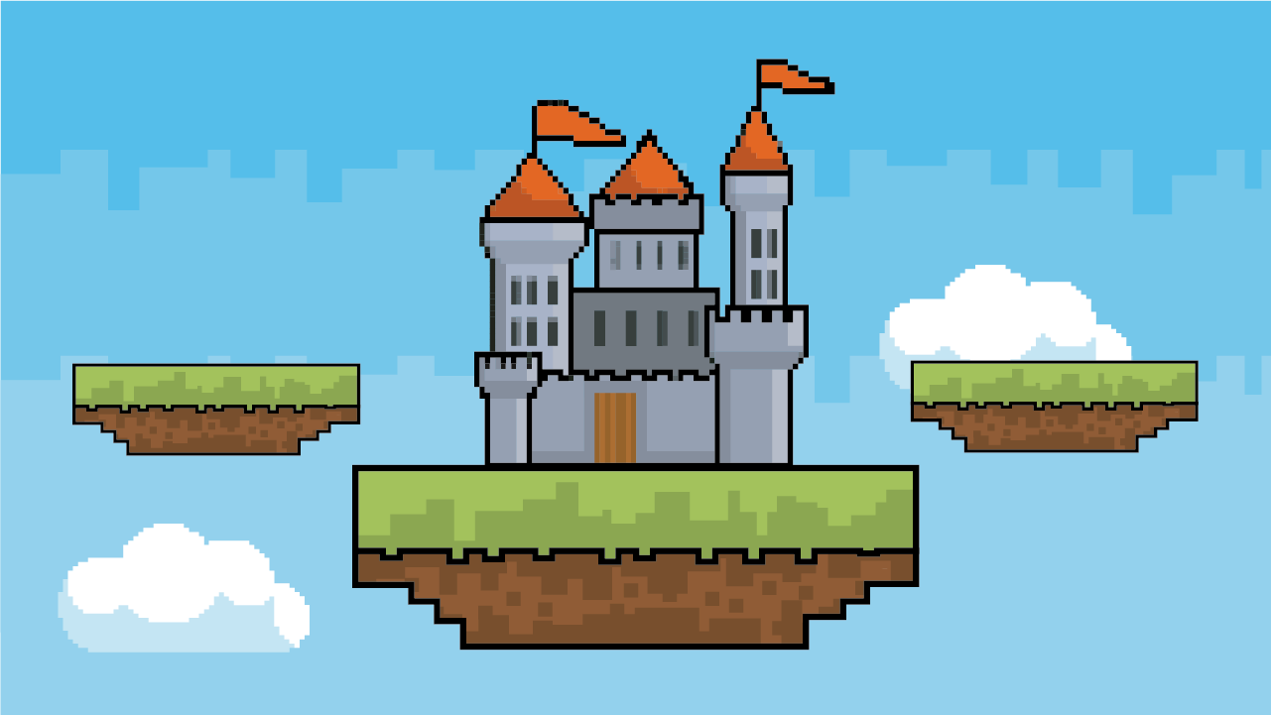
Credits
Presentation template
by Slides for Education
Illustrations and
infographics by Freepik
Photos created by Unsplash
27

